Slide 1



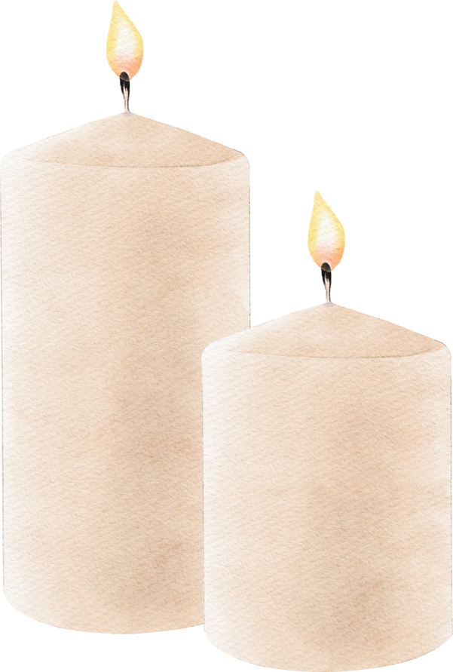

The Becket School
Quiz!
Lift out a pen and piece of paper, work in pairs or on your own (staff decision) and let us know in the comments box in Be Inspirational, who gets the most points!

Slide 2
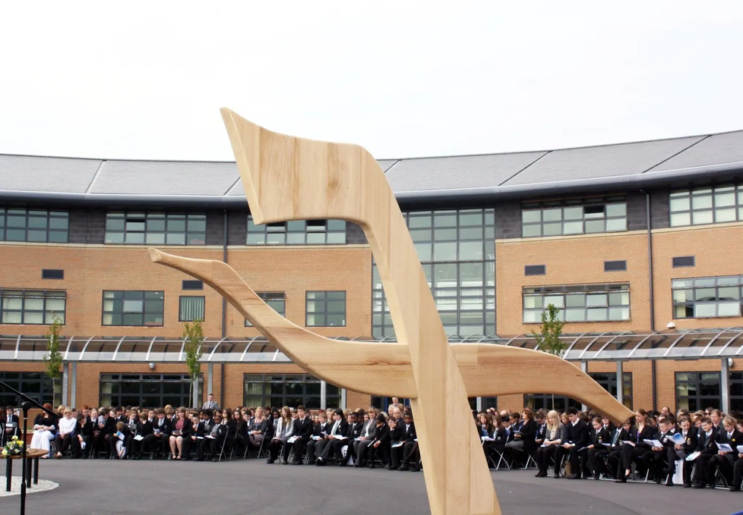
  What year did the Becket School move to this new building?

Slide 3
What year did the Becket School move to this new building?
The Becket school moved to its new site, on The Becket Way, at the beginning of the 2009–2010 academic year.

Slide 4
2. How many correct current Becket staff can you name who are past Becket students?

Slide 5
2. How many correct current Becket staff can you name who are past Becket students?
Clue * - There are 5 staff members!

Slide 6
2. How many correct current Becket staff can you name who are past Becket students?
Mrs Shenton
Mr Belshaw
Mr Ryder
Mrs Hanson Chambers
Ruth

Slide 7
3. What does “Laborare Est Orare” mean on our school badge?
*Big bonus point if you can name which saint founded the motto?!

Slide 8
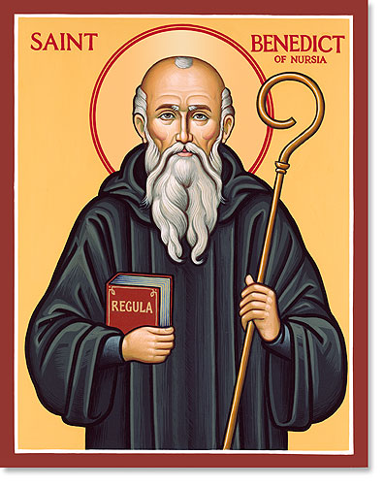
3. What does “Laborare Est Orare” mean on our school badge?
The Latin of our motto literally means “work is prayer” or more commonly “to work is to pray” and comes from the Catholic order of Benedictine monks who believed that they could offer their work as a devotion to God.
Not only is this fitting for school students, St Benedict, from whom the Benedictine Order get their name, is also the patron saint of education.

Slide 9
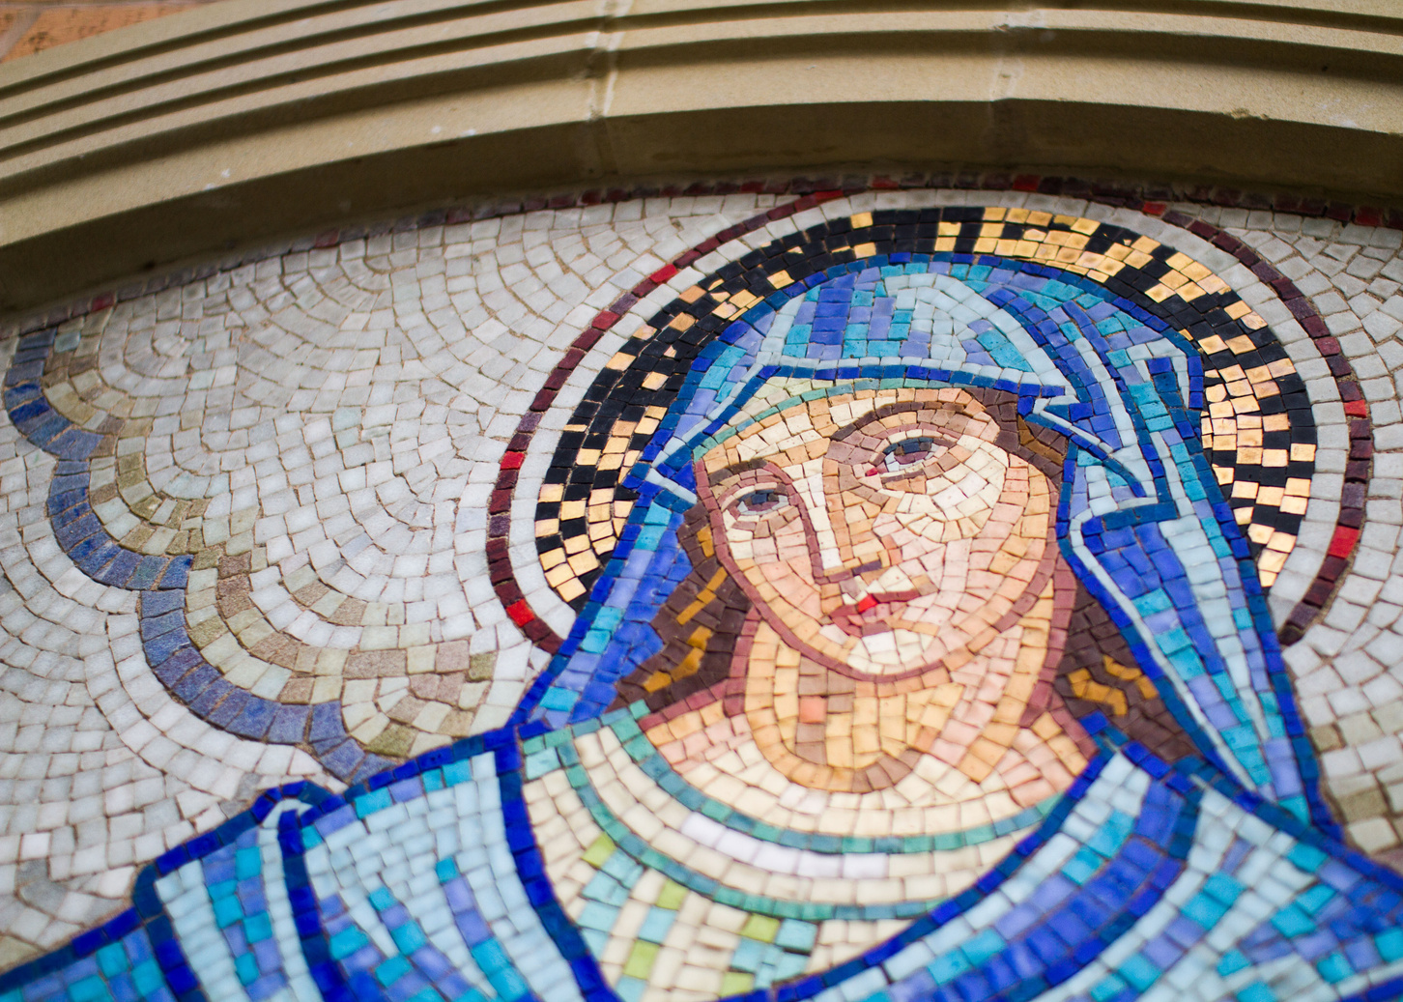
4. Whose statue is behind the Mary mosaic (from the old Becket) at the front of School?

Slide 10
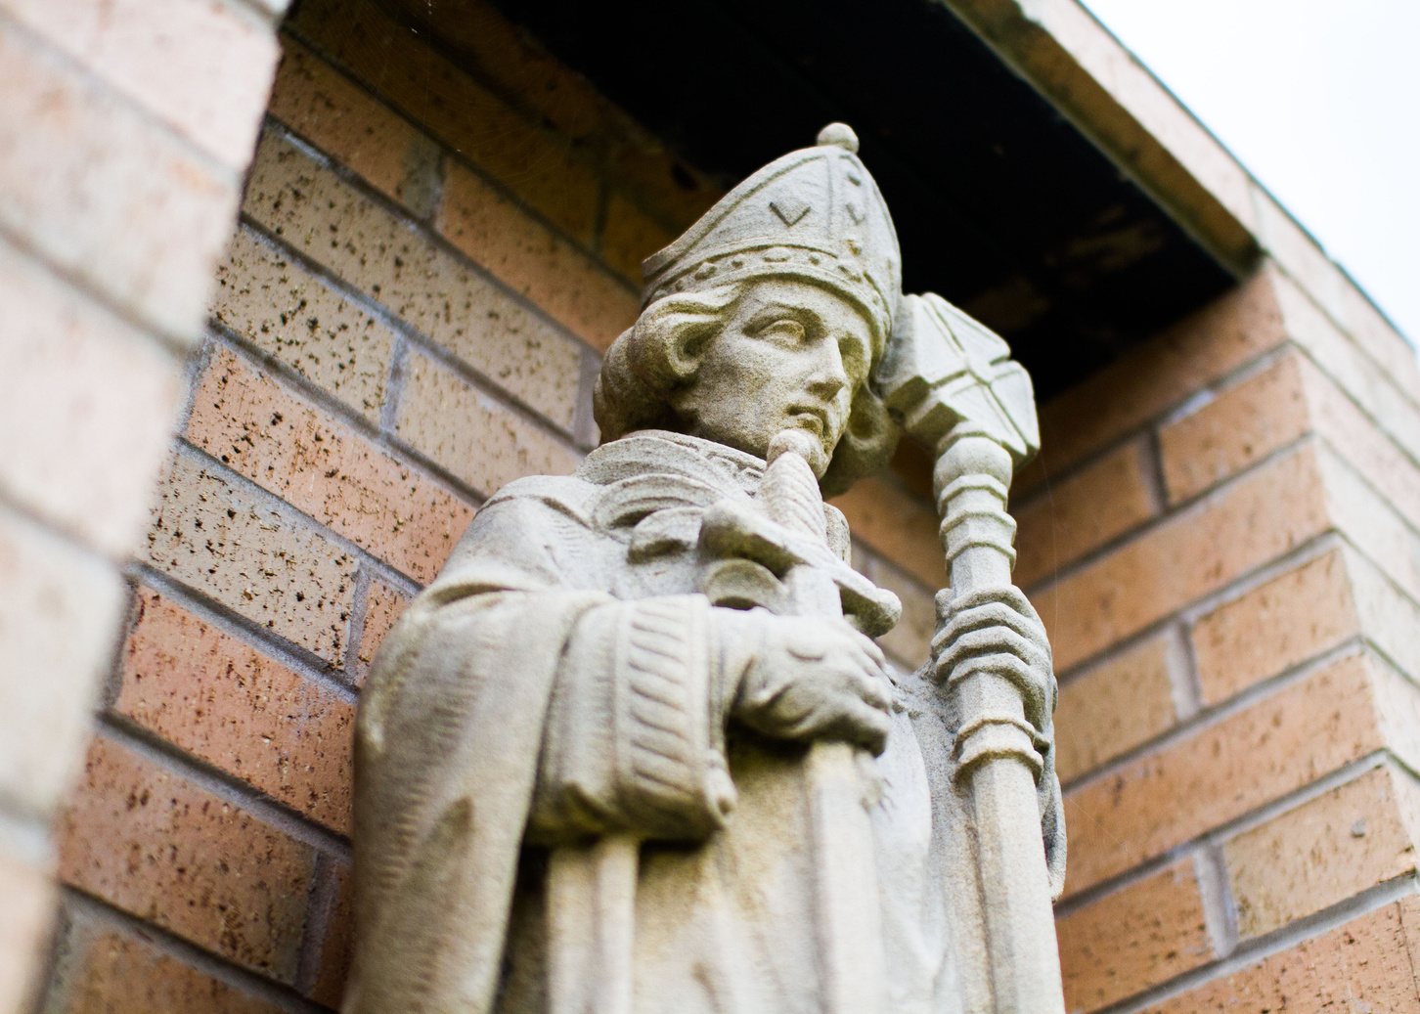
4. Whose statue is behind the Mary mosaic (from the old Becket) at the front of School?
Saint Thomas Becket, our school patron!

Slide 11
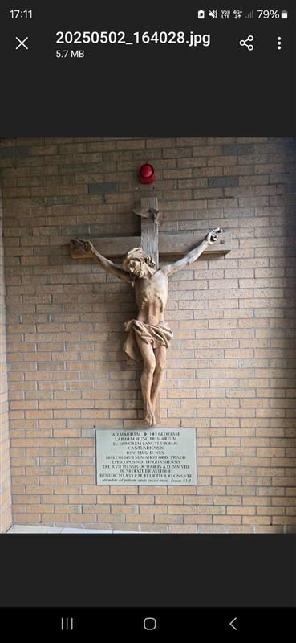
5. Which bishop blessed the foundation stone of the new Becket school building?

Slide 12
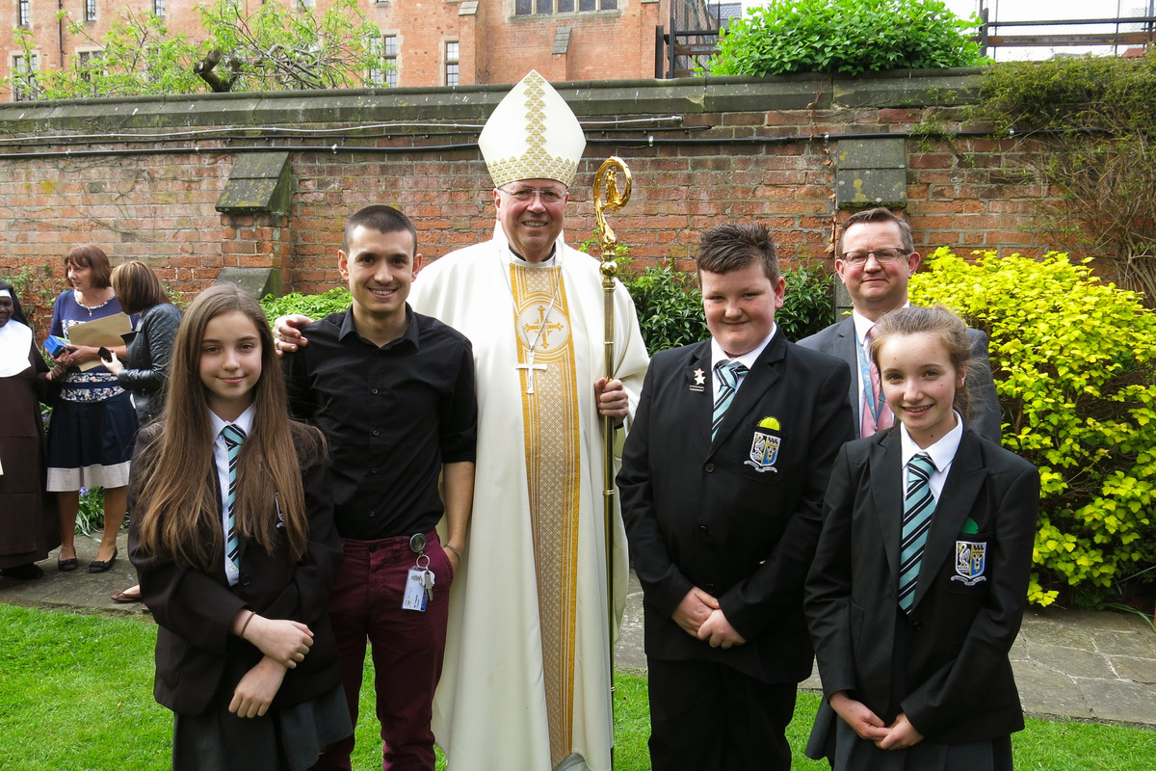
5. Which bishop blessed the foundation stone of the new Becket school building?
Bishop Malcolm (9th Bishop of Nottingham, Bishop Malcolm is now the Bishop of Liverpool)

Slide 13
6. In the chapel, what colour are the walls on the sanctuary and what colour is the carpet on the sanctuary?

Slide 14
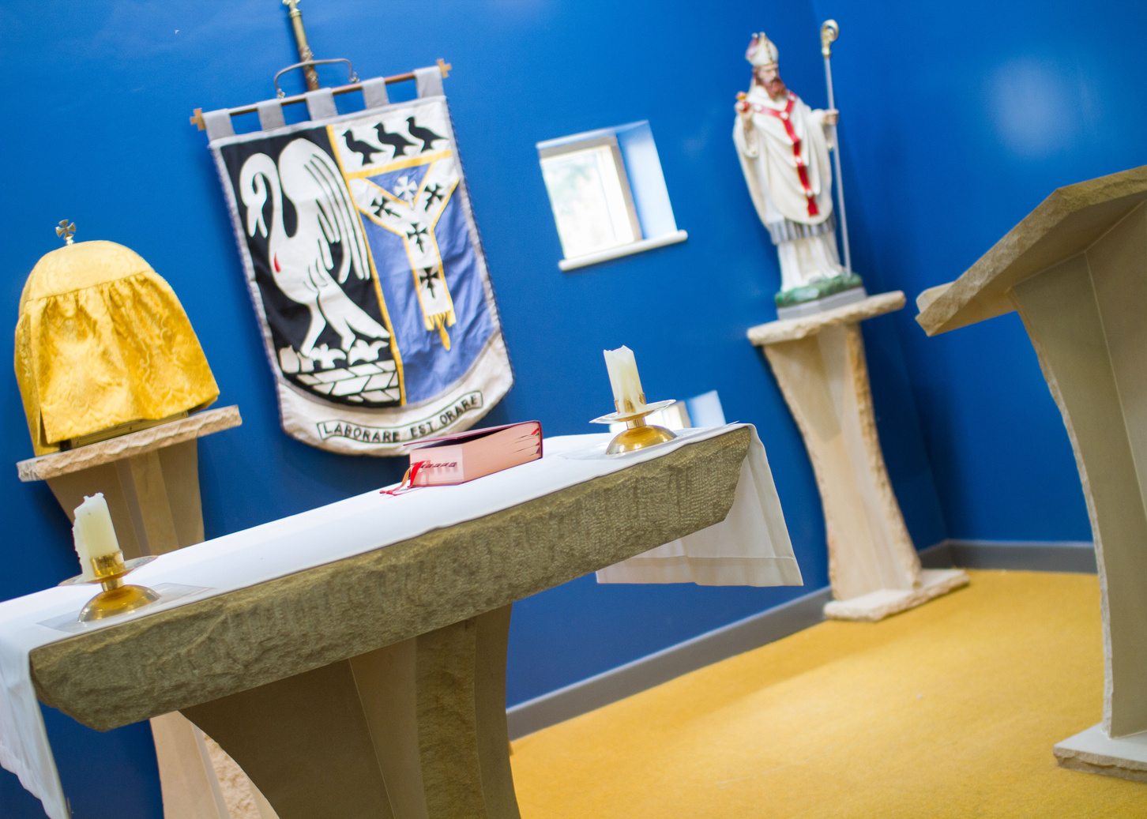
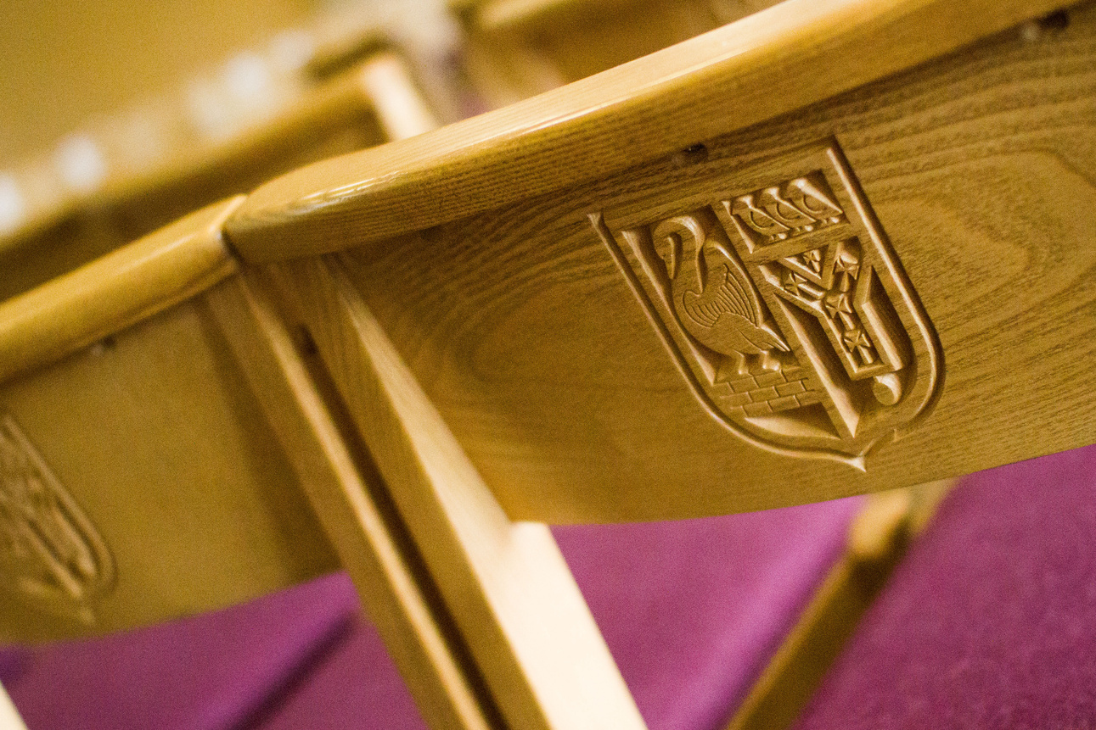
6. In the chapel, what colour are the walls on the sanctuary and what colour is the carpet on the sanctuary?
Blue walls and golden carpet - Becket colours! The chapel was carefully designed to reflect and celebrate our patron and history.
The sanctuary is the most sacred part of a Catholic church or chapel. It's the area around the altar, where the priest celebrates Mass - where the bread and wine become the body and blood of Jesus. The word "sanctuary" means holy place.

Slide 15
7. Can you fully name all 6 houses?
(4 are ‘saints’ and
2 are ‘blessed’!)

Slide 16
7. Can you fully name all 6 houses?
  Saint Bernadette Soubirous (Lourdes)
  Saint Edmund Campion (an English Martyr)
  Blessed Nicholas Garlick (an English Martyr)
  Saint Patrick
  Blessed Robert Ludlam (an English Martyr)
  Saint Thérèse of Lisieux

Slide 17

8. What was the song used for this year’s school music video? (2024)

Slide 18
8. What was the song used for this year’s school music video? (2024)
Unwritten by Natasha Bedingfield!
Let’s finish it by watching it as we celebrate our wonderful faith community, patron and building this week!

Slide 19
2024 - 2025 School Music Video
Enjoy!
https://drive.google.com/file/d/1C6QMCFd5a3syORqO0CXMRtGyY7o_AWYj/view?usp=sharing

