Slide 1
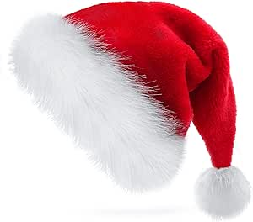
The Becket Christmas Quiz 2025!

Slide 2
Rounds….
Round 1: Guess the staff member’s voice!
Round 2: EMOJI Christmas films
Round 3: Observation round (Home alone 2)
Round 4: Name that tune!
Round 5: Christmas Dingbats
Round 6: 2025 Trivia!
Marks out of 60!

Slide 3

Round 1: guess the staff member’s voice- Home alone 2 reference!
1
2
3
4
5
6
7
8
9
10

Slide 4
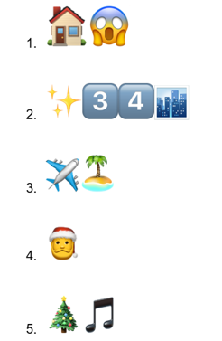
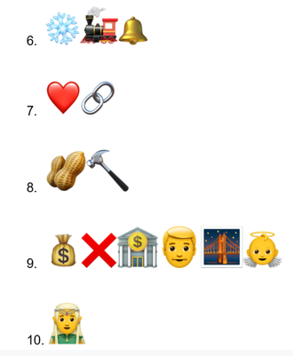
Round 2: EMOJI Christmas films

Slide 5
Round 3: Observation Home alone 2!
You are going to watch a short clip from home alone 2. watch it as a group and then try to answer the 10 questions on the next slide…
Tutors this clip is: https://www.youtube.com/watch?v=h_bUcNjmuSk

Slide 6
Round 3: Observation home alone 2
What is Kevin watching on the TV that he uses to trick others?
Who does Kevin pretend the angry gangster figure on the screen is threatening?
What city is Kevin in during this scene?
What festive phrase does the gangster on TV shout?
What object does Kevin hold while showing the clip to scare someone?
How do the adults react to the “movie within the movie”?
Do you see any Christmas decorations or lights in the background? Describe them.
What is the mood of the scene — funny, scary, festive, or tense?
Can you recall a sound or piece of music from the clip that felt like Christmas?
What words did the gangster character use that made Kevin’s plan work so well?

Slide 7
Round 4: Name that tune (song name)
1
2
3
4
5
6
7
8
9
10

Slide 8
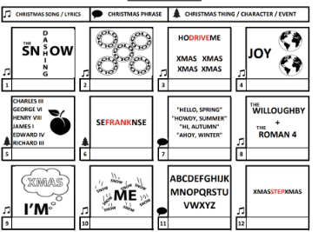
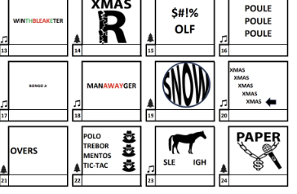
Round 5: Christmas Dingbats
Say what you see!
1
4
7
10
8
2
5
6
9
3

Slide 9
Round 6: 2025 knowledge
Squid Game remained one of the most‑popular series in 2025 — which country did it originate from?
Tottenham Hotspur won which European football trophy in 2025, ending decades without silverware?
Which 90s rock band reunited for a tour and held their first performance since 2009?
Which popular social media app was temporarily unavailable in the United States in mid-January?
Adolescence was the Netflix show people couldn't stop talking about, but what was the name of the actor who played 13-year-old Jamie Miller?
In April, an all-female crew, including Katy Perry, flew in Jeff Bezos’ rocket, but how long was their flight?
Which country won the Eurovision Song Contest?
Name one of the 3 finalists of Celebrity Traitors 2025?
As of 1st December what is the highest grossing movie of 2025?
Which Which world leader died in Rome at the age of 88 on 21st April?

Slide 10
Round 1: guess the staff member’s voice- Home alone 2 reference!
1
2
3
4
5
Mr Kemple
Mrs Harlow
Mr Mach
Mrs Hallam
Miss Aris
6
7
8
9
10
Ms Cheffings
Ms Winfield
Mr Udoh
Mr Bradley
Mr Monkman

Slide 11
Round 2: EMOJI Christmas films
Polar express
Love Actually
The Nutcracker
It’s a wonderful life
Elf
Home alone
Miracle on 34th street
The Holiday
The Santa Clause
A Christmas carol

Slide 12
Round 3: Observation home alone 2
What is Kevin watching on the TV that he uses to trick others?
👉 A black-and-white gangster film (a fake movie called Angels with Filthy Souls).
Who does Kevin pretend the angry gangster figure on the screen is threatening?
👉 The person watching / the hotel staff / the concierge (accept: “the man he’s scaring”).
What city is Kevin in during this scene?
👉 New York City.
What festive phrase does the gangster on TV shout?
👉 “Merry Christmas, you filthy animal!”
What object does Kevin hold while showing the clip to scare someone?
👉 A remote control.

Slide 13
6. How do the adults react to the “movie within the movie”?
👉 They are shocked / frightened / confused / back away quickly.
7. Do you see any Christmas decorations or lights in the background? Describe them.
👉 Yes – Christmas lights, festive décor, or hotel Christmas decorations
(allow any reasonable festive detail spotted).
8. What is the mood of the scene — funny, scary, festive, or tense?
👉 Funny (also accept: comic or light-hearted, even though it looks scary).
9. Can you recall a sound or piece of music from the clip that felt like Christmas?
👉 Christmas-style background music or festive sound effects
(accept: “no music but festive atmosphere” if justified).
10. What words did the gangster character use that made Kevin’s plan work so well?
👉 Threatening language, especially the line “Merry Christmas, you filthy animal” (and/or “Keep the change”).

Slide 14
Round 4: name that tune
Merry Christmas (Maria Carey)
Driving home for Christmsas (Chris Rea)
Merry Christmas (Ed Sheeran and Elton John)
Feliz Navidad (Jose Feliciano)
Happy Xmas (War is Over) – John Lennon
Jingle bell rock (Bobby helms)
Mistletoe- Justin Bieber
Merry Christmas Everyone (Shakin’ Stevens)
One more sleep (Leona Lewis)
Rockin around the Christmas Tree

Slide 15
Round 5: Christmas Dingbats
Say what you see!
Step into Christmas
Christmas CrackER
Dashing through the snow
Joy to the world
Wrapping paper
Away in a manger
Kings Speech
Leftovers
Dreaming of a white Christmas
Minced pie

Slide 16
Round 6: 2025 knowledge
Squid Game remained one of the most‑popular series in 2025 — which country did it originate from?
Tottenham Hotspur won which European football trophy in 2025, ending decades without silverware?
Which 90s rock band reunited for a tour and held their first performance since 2009?
Which popular social media app was temporarily unavailable in the United States in mid-January?
Adolescence was the Netflix show people couldn't stop talking about, but what was the name of the actor who played 13-year-old Jamie Miller?
In April, an all-female crew, including Katy Perry, flew in Jeff Bezos’ rocket, but how long was their flight?
Which country won the Eurovision Song Contest?
Name one of the 3 finalists of Celebrity Traitors 2025?
As of 1st December what is the highest grossing movie of 2025?
Which Which world leader died in Rome at the age of 88 on 21st April?
South Korea
UEFA Europa league
Oasis
TikTok
Owen Cooper.
11 minutes
Austria
Alan Carr, Nick Mohammed
or David Olusoga
9. Lilo and Stitch
10. Pope Francis

Slide 17
MARKS
OUT OF
60!
Email MR UDOh your FORM and total score

