Slide 1


AN INTRODUCTION TO
LENT

Slide 2

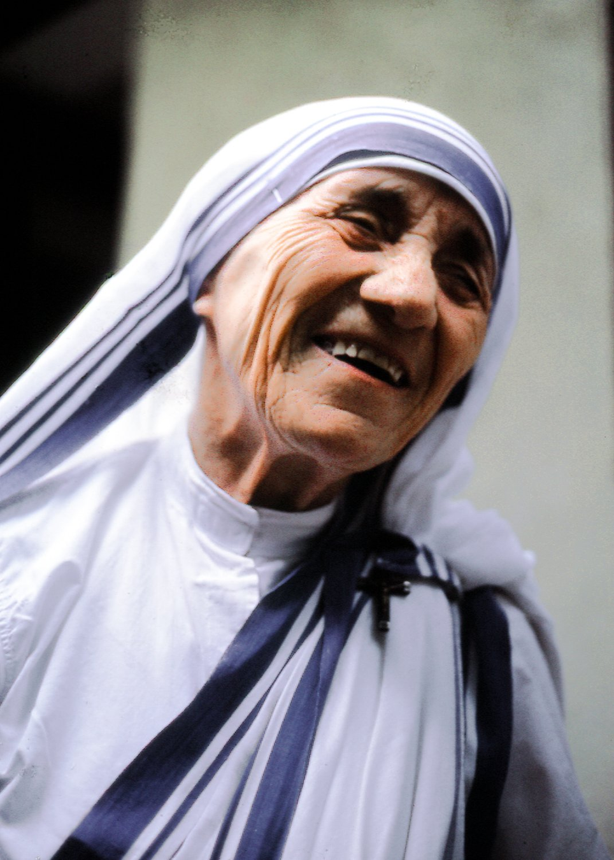
St. Teresa of Calcutta
"Lent is a time for greater love. Listen to Jesus’ thirst...
He wants only your love."

Slide 3

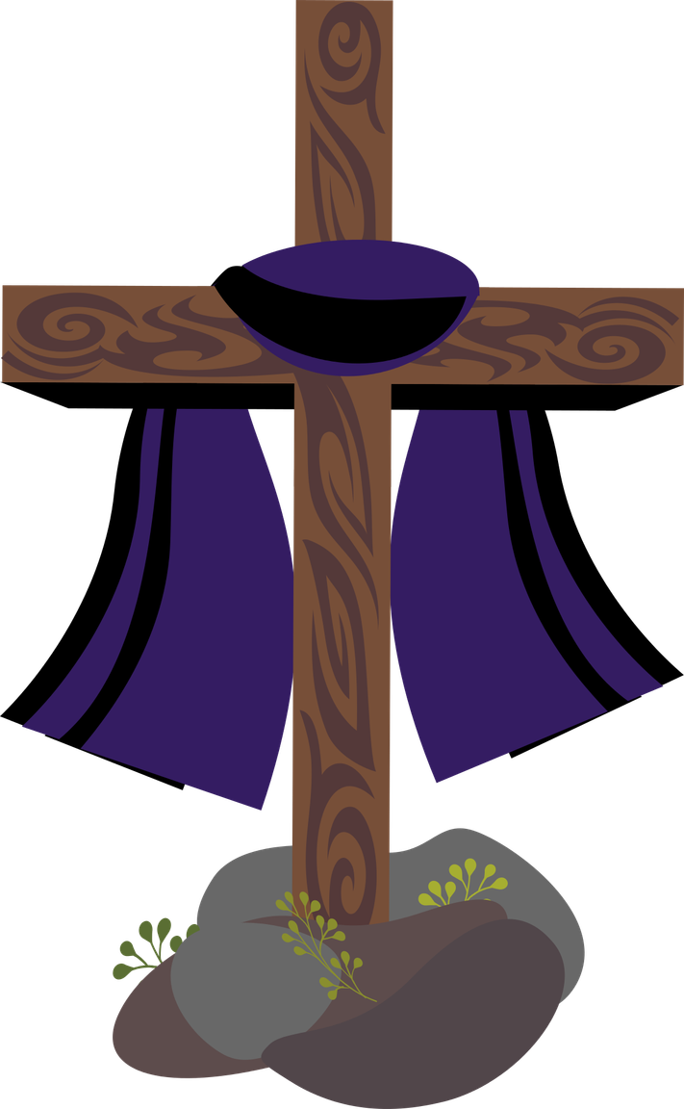

When does Lent begin?
  Shrove Tuesday
  Ash Wednesday
  Palm Sunday

Slide 4
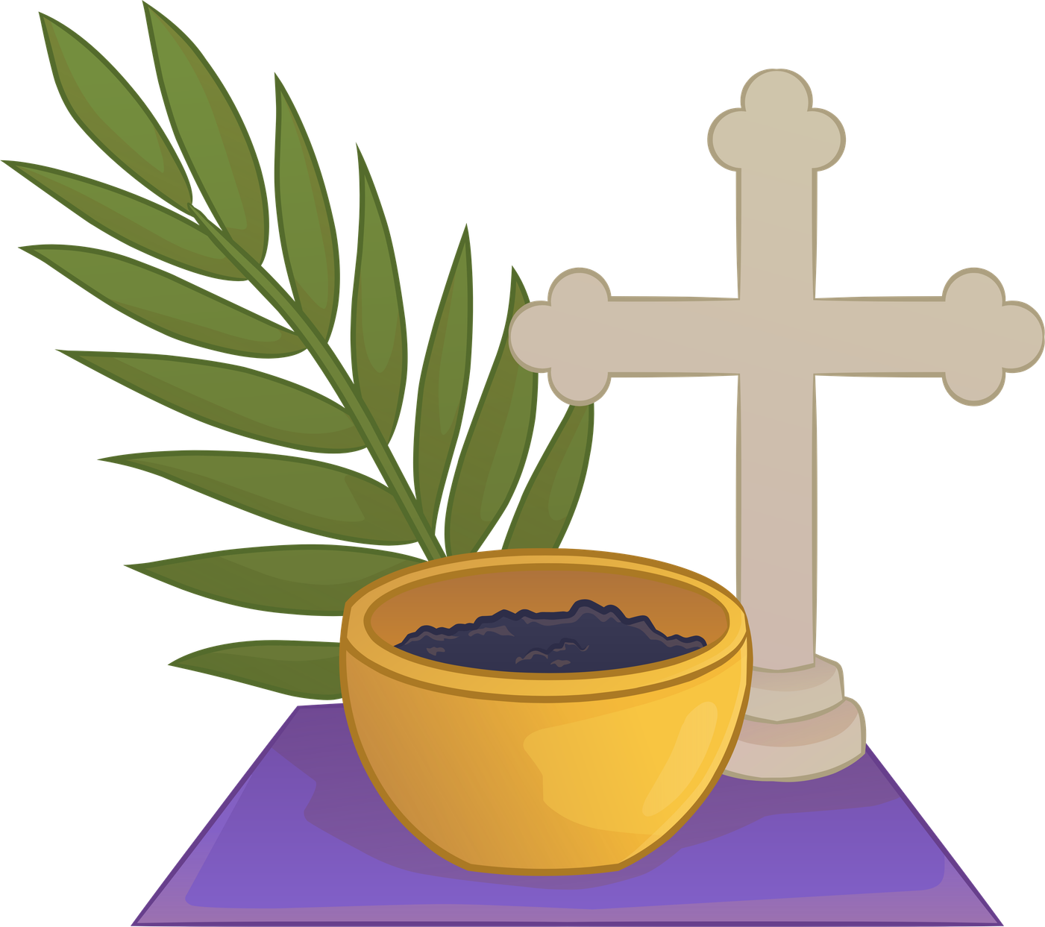
When does Lent begin?
  Lent begins on Ash Wednesday and lasts for 40 days (excluding Sundays)
  On Ash Wednesday, we are invited to receive ashes on our foreheads as an outward sign of the start of our Lenten journey and openness turn back to God and seek His forgiveness.
  “Remember that you are dust, and to dust you shall return.”

Slide 5
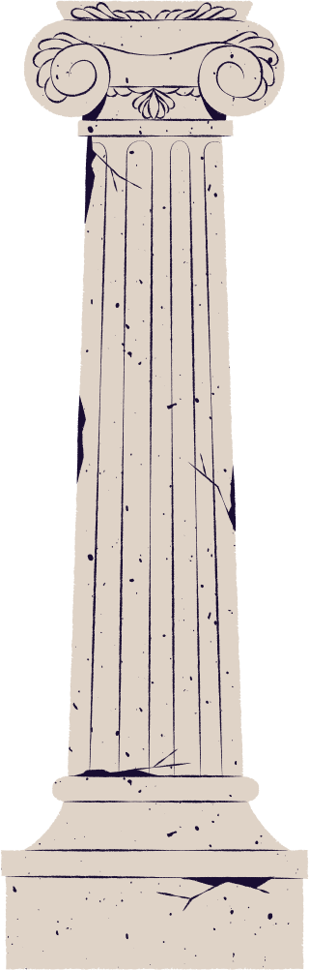
What are the three pillars of Lent?
  Faith, Hope, Charity
  Work Hard, Be Loving, Do the Right Thing
  Prayer, Fasting, Almsgiving

Slide 6
In Lent, Catholics make an extra effort to practise the 3 pillars of Lent, with the hope of growing closer to God.
Prayer - communicating with God and building a relationship with Him (silence, scripture, making time)
Fasting - practising self discipline and giving up things that might distract us from God (gossiping, social media, alcohol, fast fashion, indulging in treats)
Almsgiving - giving to those who are in need (with time, acts of kindness, donations)

Slide 7
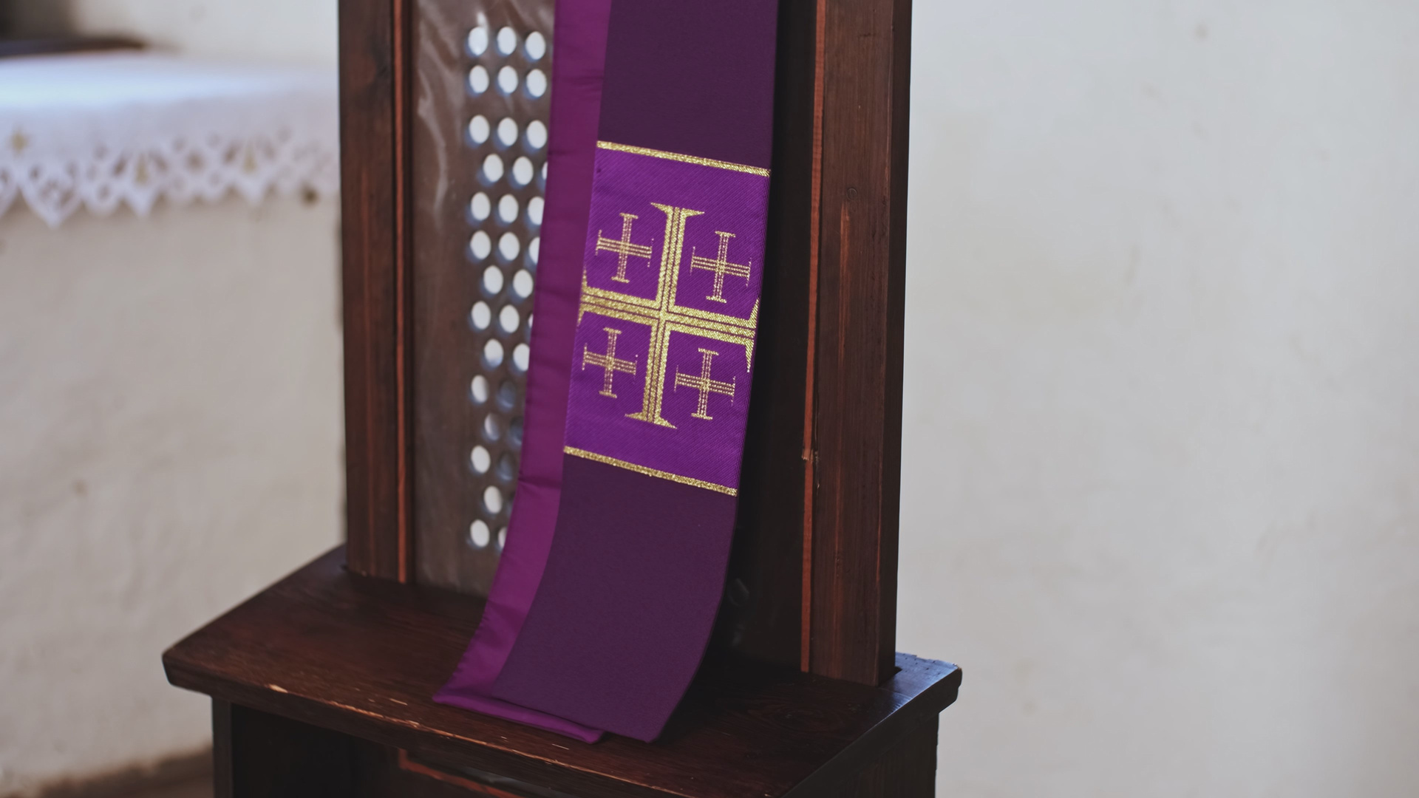
What two key elements are omitted from the Mass during the season of Lent?
  Alleluia and the Lord’s Prayer
  Gloria and Alleluia
  Creed and the Sanctus

Slide 8
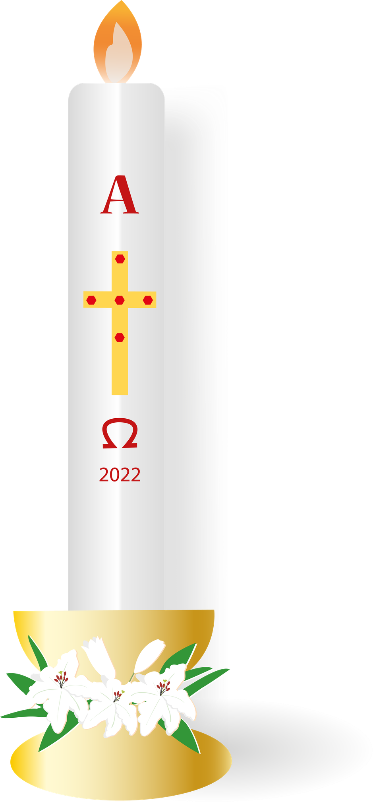
During Lent, the Church removes the Alleluia and the Gloria from the liturgy to reflect the simplicity, penitential, and spiritually reflective atmosphere of the season.
  Alleluia is a very joyous word meaning “Praise the Lord”. We still have a Gospel acclamations but without the A word—using a psalm or verse before the Gospel instead.
  Gloria (“Glory to God in the highest…”) is a very ancient and venerable hymn in which the Church glorifies God—again, this is omitted to reflect the more solemn tone of Lent. The Gloria returns on the Easter Vigil with bells and is full of Easter joy!

Slide 9
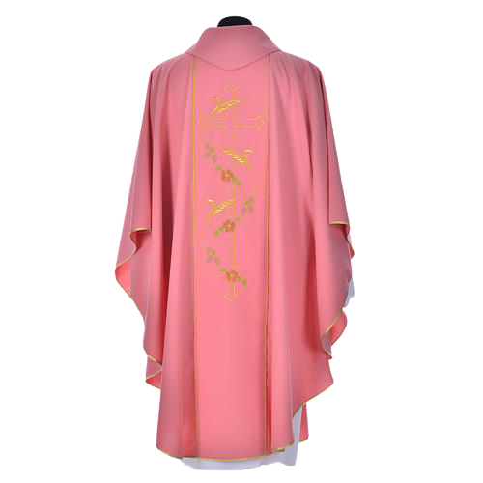
On which Sunday in Lent does the Liturgical colour change from purple to PINK (ROSE)?
  Palm Sunday
  Laetare Sunday (Fourth week of Lent)
  The final Sunday of Lent

Slide 10

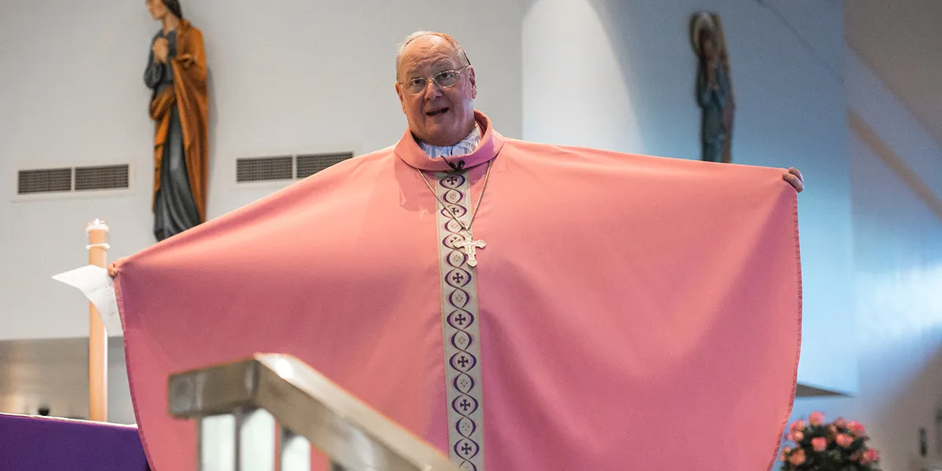
2. Laetare Sunday (Fourth week of Lent)
  This day is also known as “Refreshment Sunday” or “Mid-Lent Sunday” and falls on “Mothering Sunday”
  Laetare comes from the Latin word meaning rejoice
  The colour rose serves as a symbol of joy and hope - a reminder of the upcoming celebration of Easter we are preparing for!

Slide 11
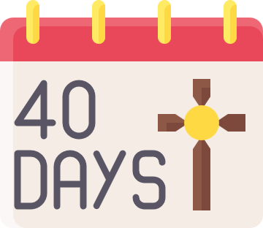


“Catholics have to fast throughout the whole of Lent”
True
or
False
*46 days including
Sundays

Slide 12
False
  Fasting is a form of penance and self discipline.
  Catholics are only required to fast on Ash Wednesday and Good Friday. Additionally, Catholics abstain from Meat on Fridays.
  However, there are certain feast days when feasting takes place in Lent (Saint Joseph 19th March, Annunciation 25th March, Saint Patrick 17th March)
*46 days including
Sundays

Slide 13


Which sacrament is particularly emphasised during the season of Lent?
  Confirmation
  Baptism
  Reconciliation
Sacraments are the visible form of the invisible grace
Saint Augustine

Slide 14
Which sacrament is particularly emphasised during the season of Lent?
Reconciliation
Lent highlights Reconciliation for restoring grace and friendship with God (and others around us), offering "clean slates and fresh starts". Reconciliation offers a true 'spiritual resurrection' before celebrating Christ's Resurrection.
Due to mocks, Becket’s Reconciliation morning will be moved to Friday 20th March. A sign up sheet will be shared with tutors in the leadup.

Slide 15
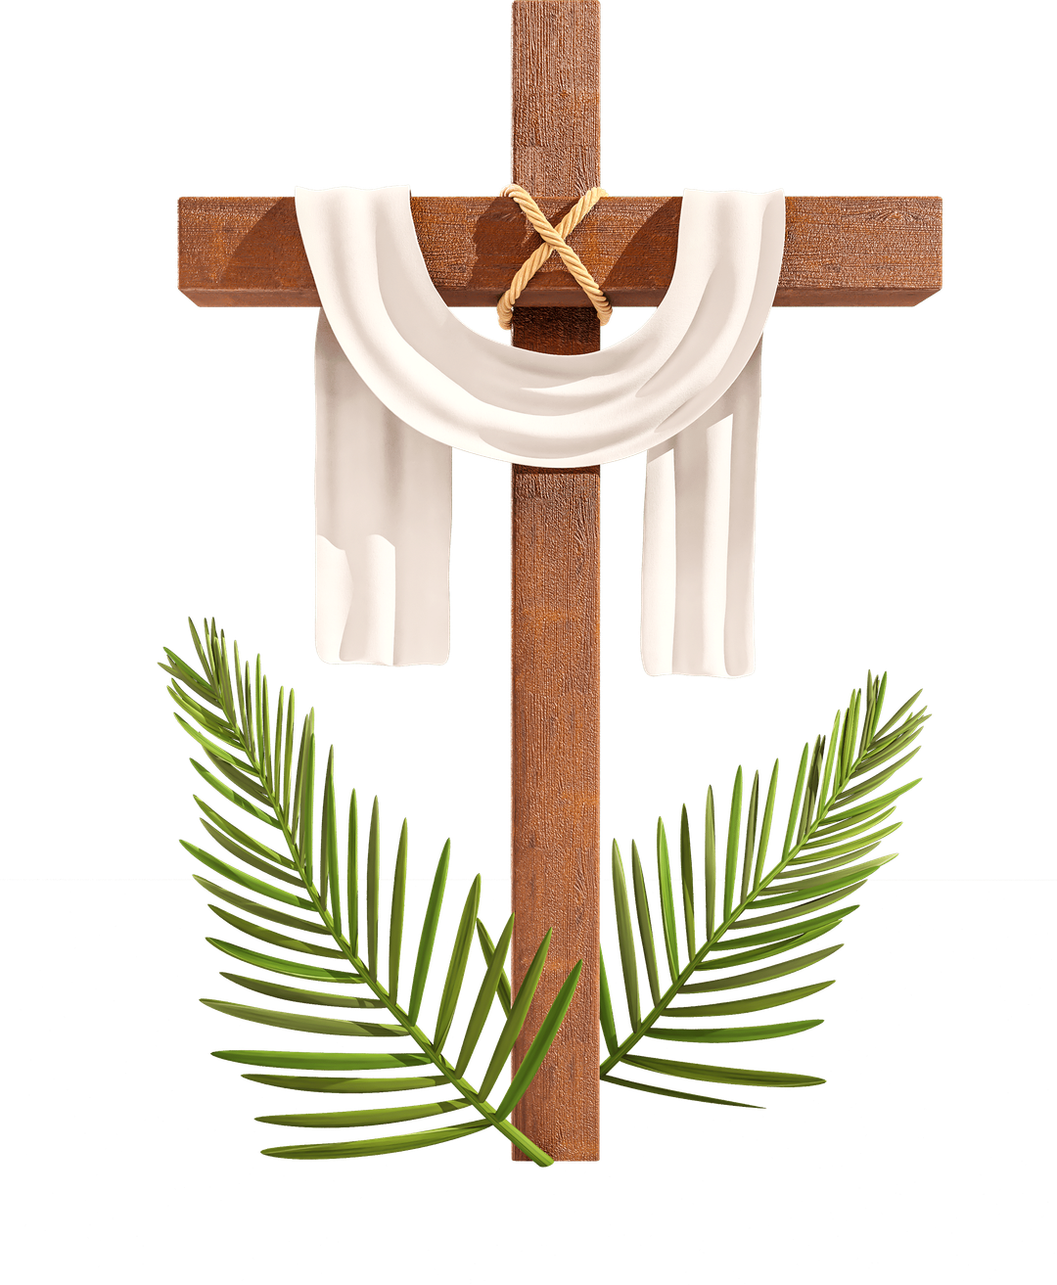
What are you doing extra or giving up this Lent?
What might you find challenging or sacrificial this half term?
What are you looking forward to this half term?

Slide 16
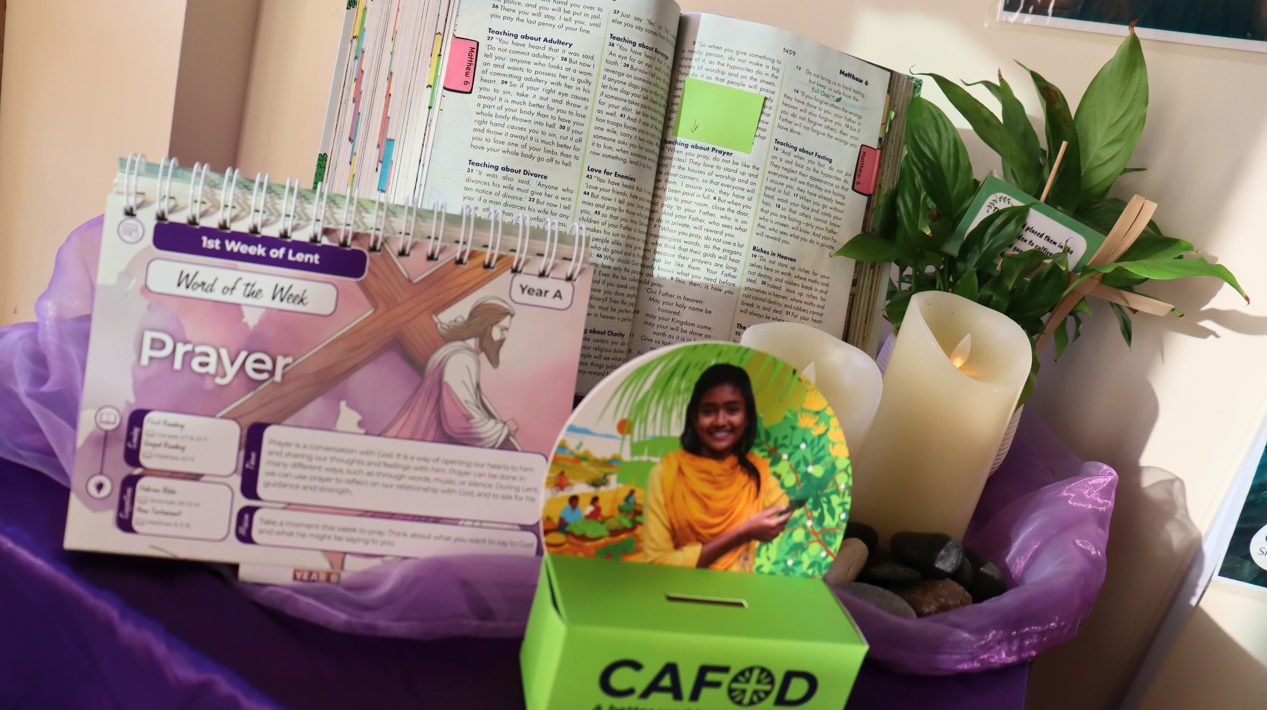
Some Lenten gifts for your forms to take away with you!

