Slide 1

almsGiving
3rd Sunday of lent

Slide 2

Let us gather together…
In the name of the Father, and of the Son, and of the Holy Spirit, Amen.
Gather

Slide 3

almsGiving
Almsgiving is where we care for other, serving each other and putting the needs of others before ourselves.
Gather

Slide 4

A reading from the Holy Gospel according to Matthew
Glory to you O Lord.
“For I was hungry and you gave me something to eat, I was thirsty and you gave me something to drink, I was a stranger and you invited me in, I needed clothes and you clothed me, I was sick and you looked after me, I was in prison and you came to visit me.
Then the righteous will answer him, “Lord, when did we see you hungry and feed you, or thirsty and give you something to drink? When did we see you a stranger and invite you in, or needing clothes and clothe you? When did we see you sick or in prison and go to visit you?”
The King will reply, ‘Truly I tell you, whatever you did for one of the least of these brothers and sisters of mine, you did for me.’”
The Gospel of the Lord
Praise to you Lord Jesus Christ
The Word

Slide 5

In the scripture, Jesus tells his followers that we MUST
feed the hungry, give clean water to the thirsty and help those who are sick.
We must live our lives in the way God intended us to; overflowing with love, mercy and compassion.
Throughout the scriptures, at the very core of Jesus’ message, we see that He is there for those in need. We must too act as Jesus did and be continuously mindful of the needs of others.
Every small act, every small donation and every small coin you give has a huge impact on the lives of people in need.
Together, we can do great things!
The word

Slide 6


mission
This Lent we are launching our Give a Gift appeal!
World Gifts is an extension of CAFOD, where you can choose to buy a gift for someone in need.
There is a huge range of gifts to choose from, some that provide emergency care for people in need around the world, others that will support people and help them build a better life for themselves and their communities.

Slide 7
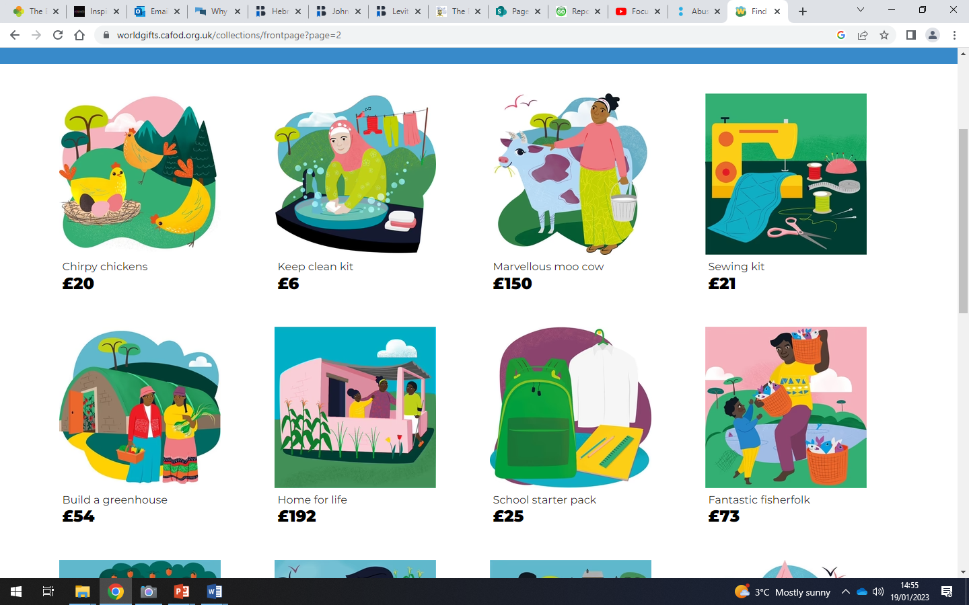
What can you give?

Slide 8
Do the Maths!
Let’s say there’s 30 of you in your form…
How much does each person need to raise to gift someone in need a school starter pack?
84p!

Slide 9
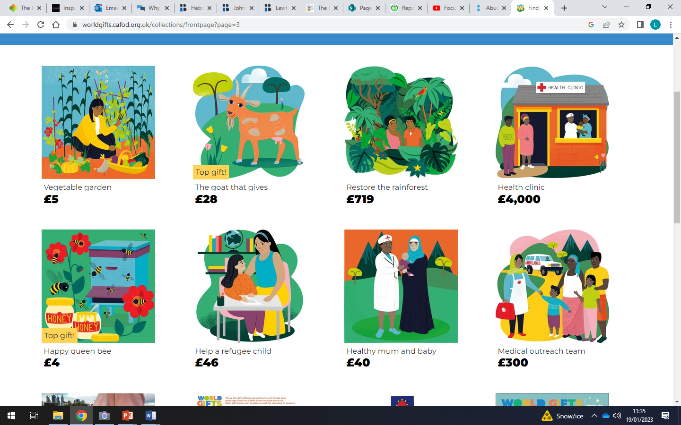
What can you give?

Slide 10
Do the Maths!
Let’s say there’s 30 of you in your form…
How much does each person need to raise to gift a community in need a medical outreach team?
£10!

Slide 11
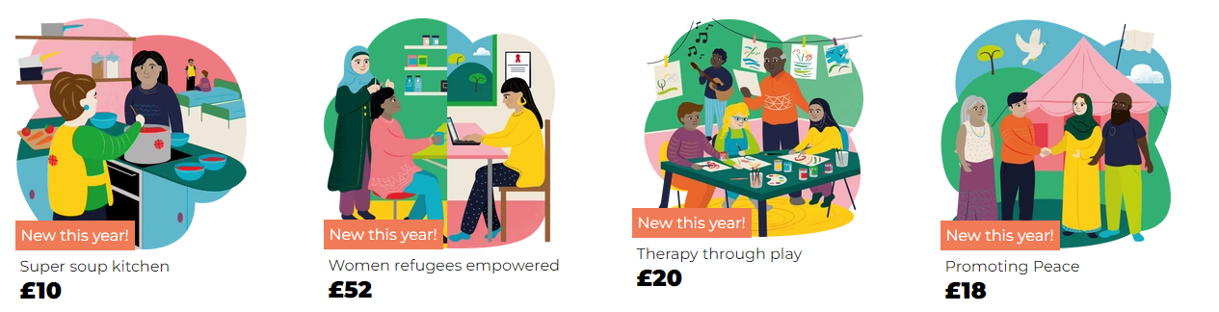
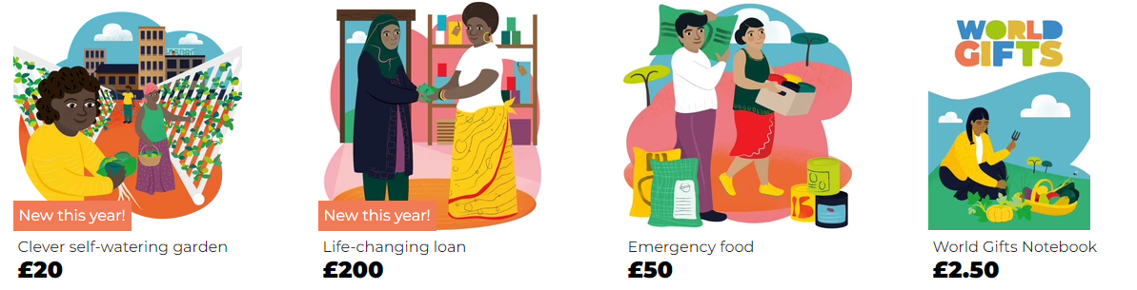
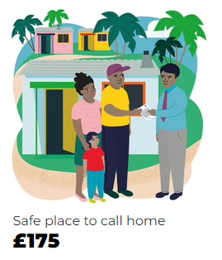
What can you give?

Slide 12
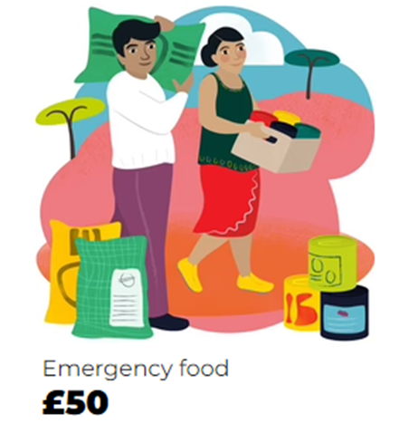
Do the Maths!
Let’s say there’s 30 of you in your form…
How much does each person need to raise to gift a community emergency food?
£1.67!

Slide 13
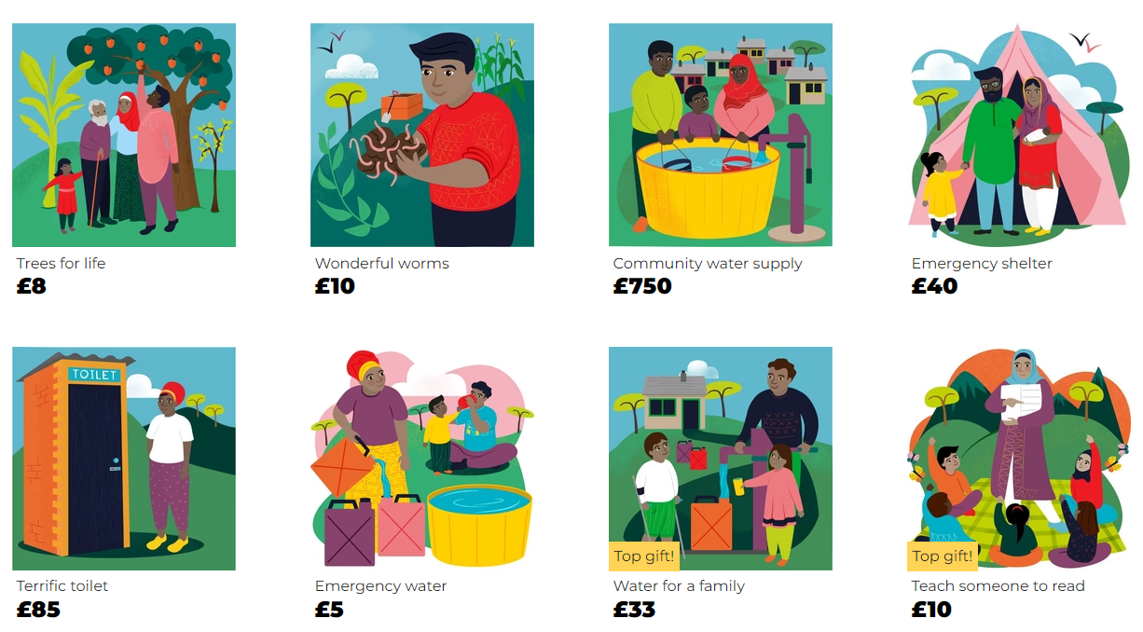
What can you give?

Slide 14
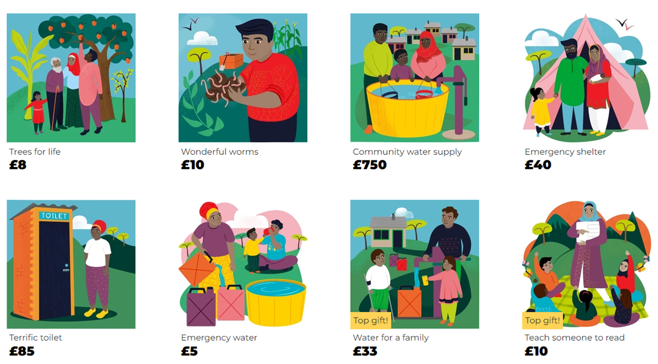
Do the Maths!
Let’s say there’s 30 of you in your form…
How much does each person need to raise to gift someone a life-changing skill of being able to read?
34p!

Slide 15
But we can do better than that!!
Let’s say there’s 30 of you in your form…
How much does each person need to raise to gift someone a life-changing skill of being able to read AND provide water for a family?
£1.44!

Slide 16
As a form you must decide on what gift or gifts you’d like to give.
You will then have 6 weeks (including the Easter holidays) to raise the money as a form and the money will be collected on
Friday 24th April.
There will be dedicated slots in form time each week to support your planning.
mission

Slide 17
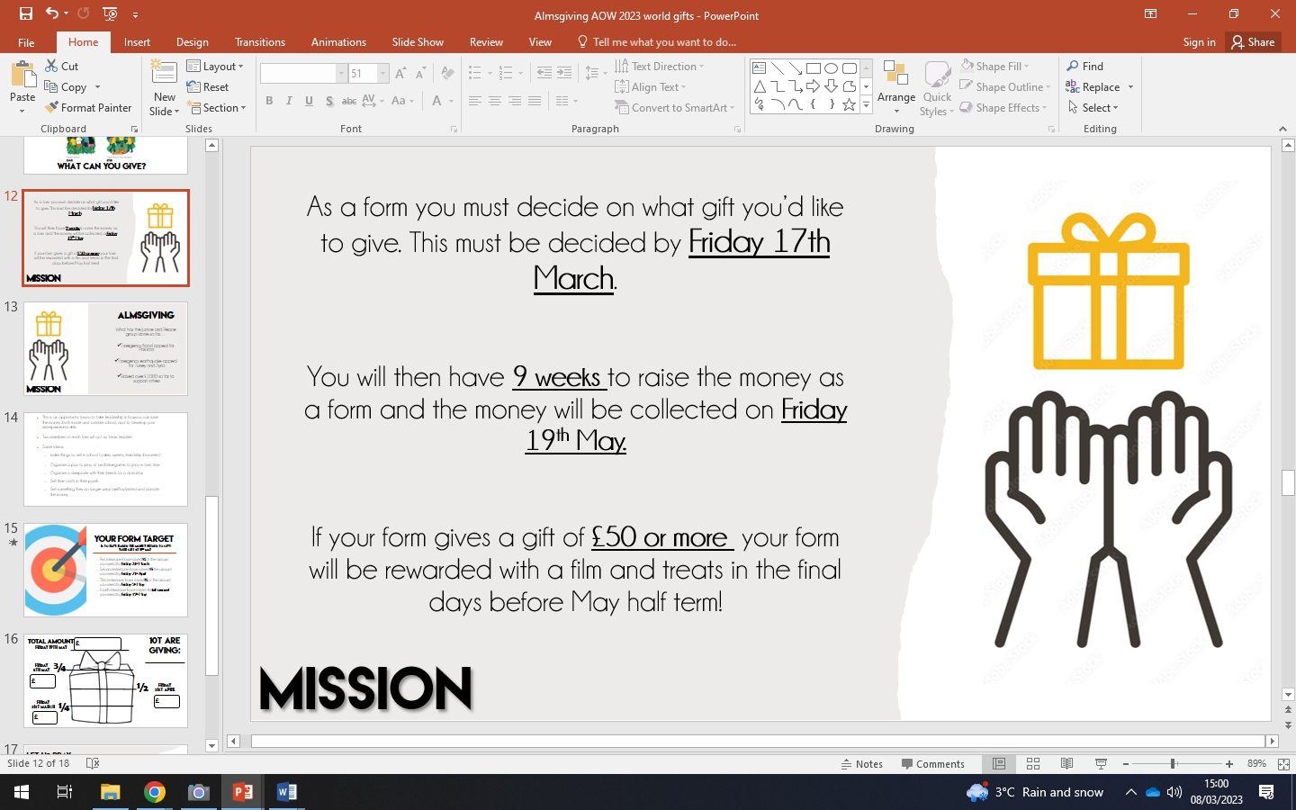
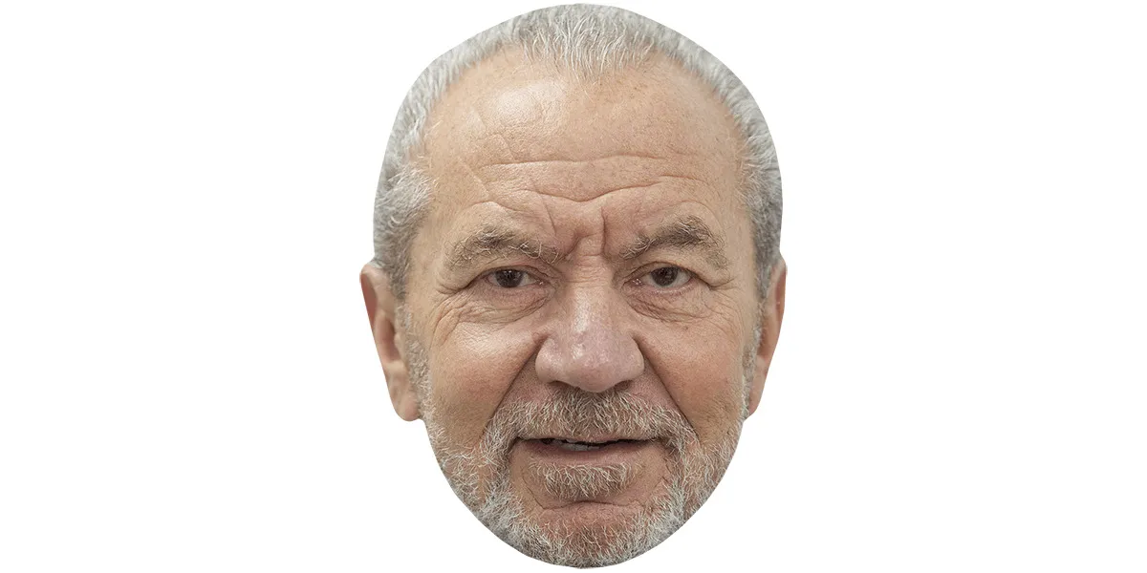
Team leaders
Team leaders need to visualise themselves on The Apprentice:
leading the form in discussions
giving people jobs, such as creating posters to advertise the events
take leadership in organising the events.
mission

Slide 18


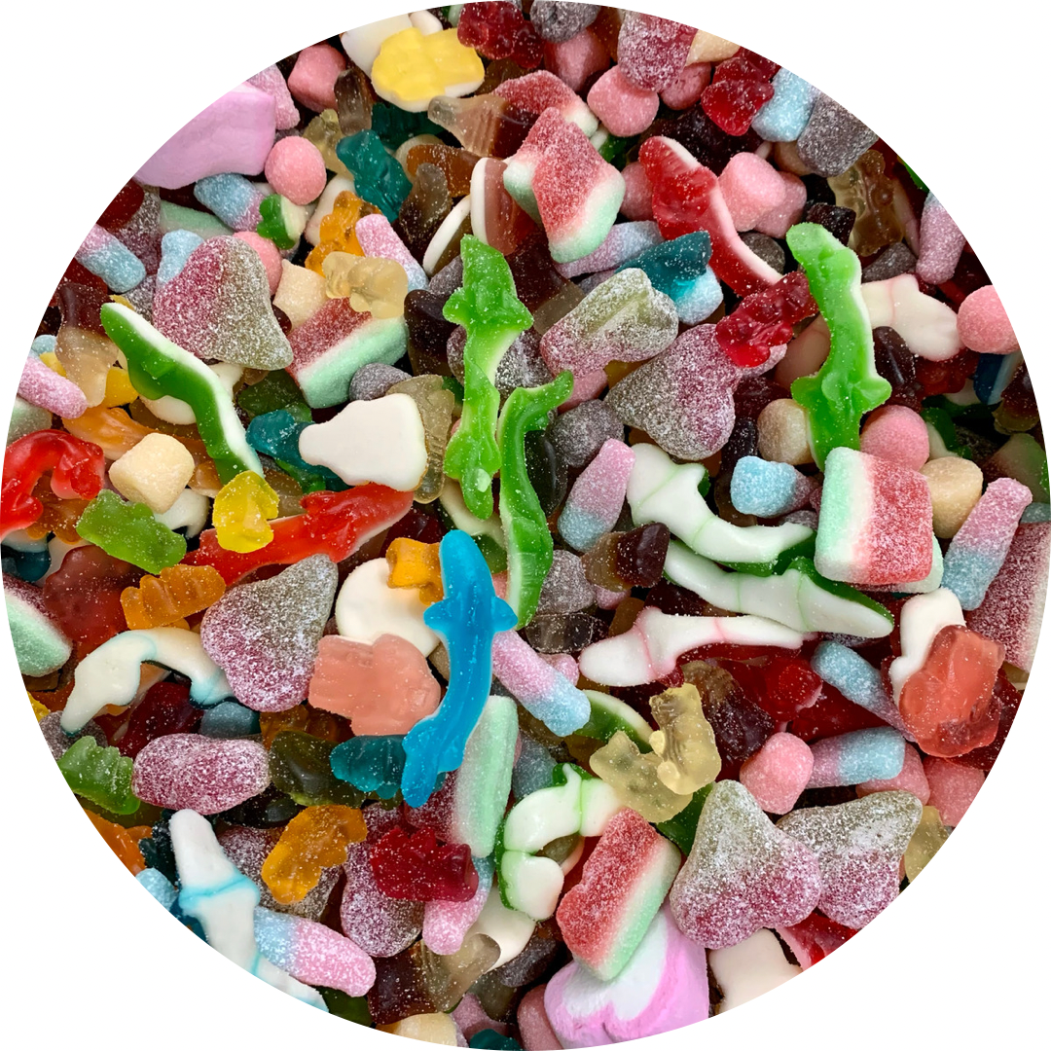

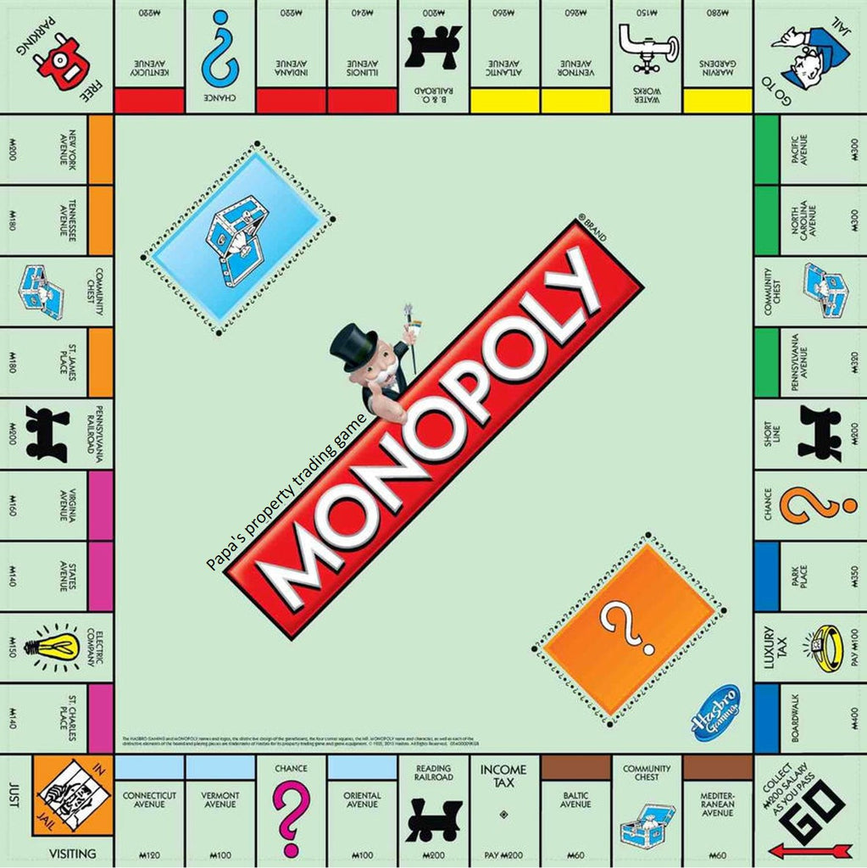
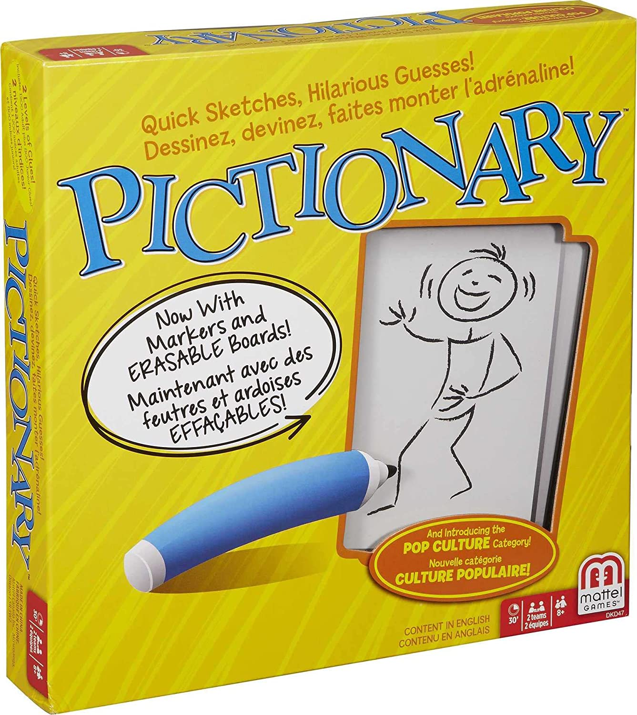

Slide 19

£
10T ARE GIVING:
_______
Total amount
Date:________
¾
£
½
£
¼
£

Slide 20

Let Us Pray…
Dear God,
We strive to be in your likeness; your kindness and compassion is at the centre of all you do. Let us be generous with our kindness and compassion to everyone we encounter. Let us think of the needs of others before our own.
You gave us the ultimate gift; life. Help us to live life in its fullest.
Strengthen us so that we might all give a gift; a gift of love, hope and dignity to the must vulnerable people in our world.
Amen

Slide 21
almsGiving
3rd Sunday of lent

